Slide 1
Ecommerce Sales Dashboard

Slide 2
Abstract
An E-commerce sales dashboard using Microsoft Power BI provides comprehensive insights into sales data by levering the advanced data visualization and analytics capabilities of Power BI. This project focuses on creating an interactive dashboard to monitor key sales metrics, track performance trends, and facilitate data-driven decision making.

Slide 3
KEYWORDS
E-commerce Sales Dashboard.
Microsoft Power BI.
Data Visualization.
Real-time Updates.
Business Intelligence.

Slide 4
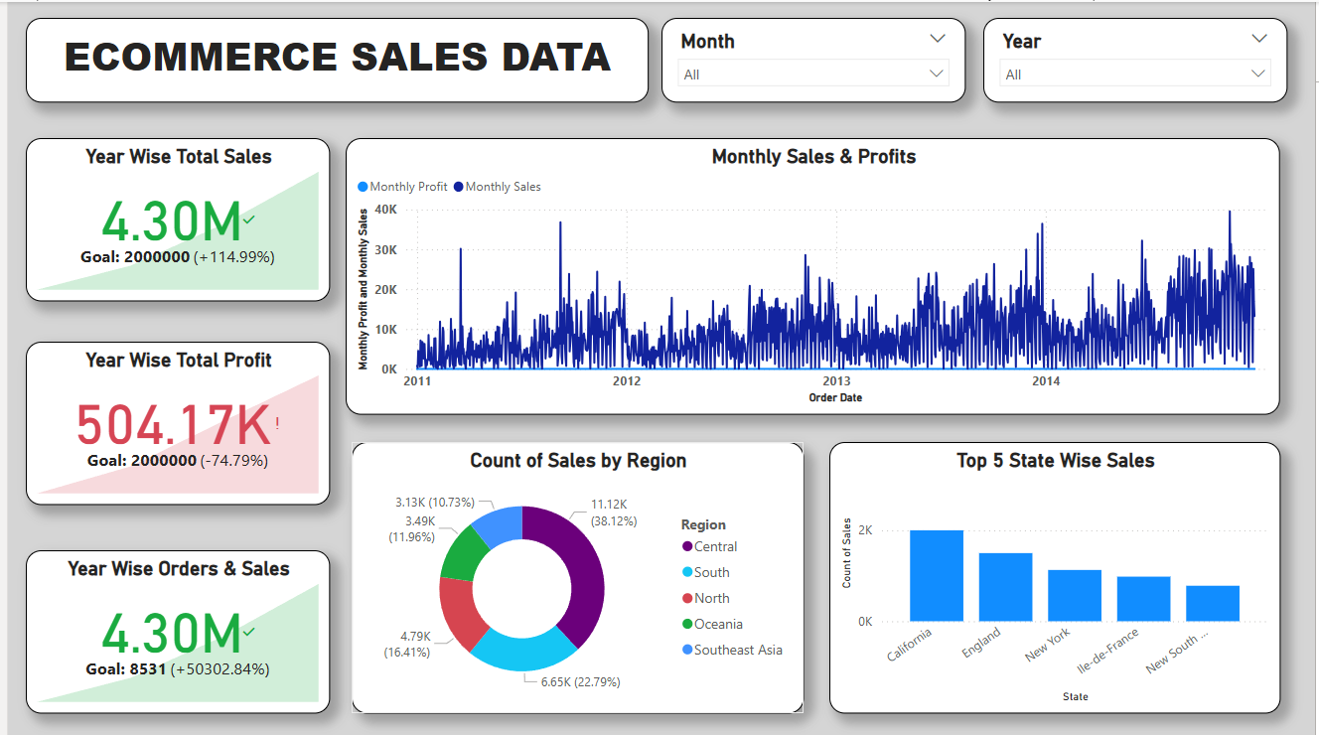
Ecommerce Sales Data

Slide 5
INTRODUCTION
E-commerce has transformed the retail landscape, enabling business to reach a global audience and operate 24/7. With the surge in online transactions, the need for efficient sales data analysis has become paramount. Traditional methods of data analysis often fall short in handling the vast and complex datasets generated by e-commerce platforms. Microsoft BI, a robust business intelligence tool, offers a solution by providing powerful data visualization and analysis capabilities.

Slide 6
OBJECTIVE
The primary objective of this project is to design and implement an e-commerce sales dashboard using Microsoft Power BI that provides real-time, interactive visualizations of sales data. This dashboard aims to:
Enhance the understanding of sales trends and patterns.
Improve the accuracy of sales forecasting.
Facilitate data-driven decision-making.
Provide customizable views for different business needs.

Slide 7
METHODOLOGIES
Data Collection: Aggregating sales data from various e-commerce platforms and databases.
Data Cleaning and Preparation: Ensuring data accuracy and consistency.
Dashboard Design: Creating an intuitive and user-friendly interface using Power BI.
Visualization: Developing visual representations of key sales metrics and trends.
Testing and Deployment: Ensuring the dashboard’s functionality and accessibility.

Slide 8
CONCLUSION
The development of an e-commerce sales dashboard using Microsoft Power BI will significantly enhance the ability of business to analyze and interpret sales data. By providing real-time insights and interactive visualizations, the dashboard will support data-drive decision-making, improve sales performance, and contribute to overall business growth.

